Slide 2


The sky is falling!
“phrase that has come to indicate a hysterical or mistaken belief that disaster is imminent.”

Slide 3
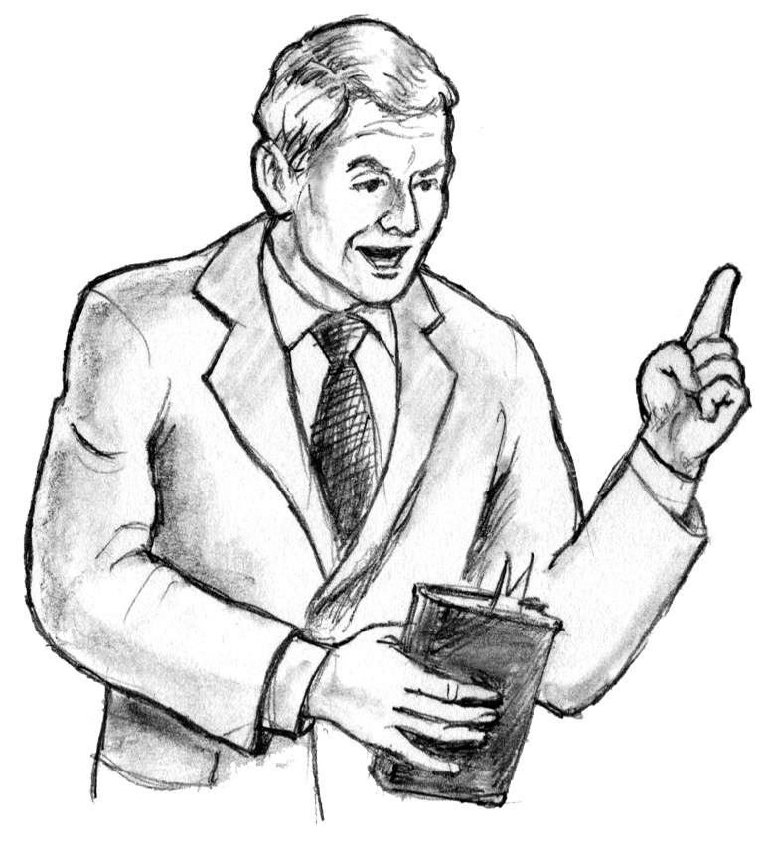
Warnings!
Jeremiah 20:7-10 “I am in derision daily; Everyone mocks me…”
Jude 17-19 “there would be mockers…who cause divisions”
Acts 17:30-32 “some mocked”
Acts 22:6-22 “they raised their voices and said, ‘Away with such a fellow’”

Slide 4
Some Won’t Take Warnings Seriously
Warnings!
Zephaniah 1:12-18 “The LORD will not do good, Nor will He do evil.” “Their blood shall be poured out like dust”
Careful People Prepare When They Are Warned
Proverbs 22:3 “a prudent man foresees evil and hides himself”
Ezekiel 33:1-9 “if you warn the wicked to turn from his way, and he does not turn from his way, he shall die in his iniquity; but you have delivered your soul.”

Slide 5
There’s A Lot To Warn About!
Warnings!
Colossians 1:26-29 “been hidden from ages and from generations, but now has been revealed to His saints.”
How Would Jesus Be Perceived By “Brethren” Today?
John 8:37-59 “you seek to kill Me, because My word has no place in you” “You are of your father the devil…” "Most assuredly, I say to you, before Abraham was, I AM."

Slide 6
Was HE An Alarmist?
Warnings!
Few Faithful – Matthew 22:1-14 “For many are called, but few are chosen”
Luke 18:7,8 “when the Son of Man comes, will He really find faith on the earth?”
False Teachers – Mark 13:22,23 “false christs and false prophets will rise and show signs and wonders to deceive, if possible, even the elect”
Worldliness – Mark 4:18,19 “deceitfulness of riches, and the desires for other things”

Slide 7
Was HE An Alarmist?
Warnings!
Not to Be Of The World – John 15:18,19 “chose you out of the world”
Against Hypocrisy – Luke 12:1 “"Beware of the leaven of the Pharisees, which is hypocrisy”
Taught On Issues – Luke 16:18 “Whoever divorces his wife and marries another commits adultery”
Luke 17:3,4 “your brother sins against you, rebuke him”
Matthew 18:15-17 “let him be to you like a heathen and a tax collector.”

Slide 8
Was HE An Alarmist?
Warnings!
Disobedient Going To Hell – Matthew 25:41,46 “everlasting fire prepared for the devil and his angels”
Truth With Plain Speech – Matthew Chapters 21-23
Demanded Complete Obedience – Matthew 5:48 “be perfect, just as your Father in heaven is perfect”
Luke 6:45 "why do you call Me 'Lord, Lord,' and do not do the things which I say?”
Taught To Be Aware – Matthew 26:41 “Watch and pray, lest you enter into temptation. The spirit indeed is willing, but the flesh is weak.”

Slide 9
Were The Apostles Alarmists?
Warnings!
Galatians 4:16 “Have I therefore become your enemy because I tell you the truth?”
Way Paul Wrote To Churches – 1 Corinthians 11:17ff; Colossians 2:8; Galatians 3:1; 5:7-9; 2 Thessalonians 1:7-9; 3:1-6
Paul Perceived As Paranoid Today – 2 Corinthians 9:2,3; Philippians 2:19; 1 Thessalonians 3:1-5
Peter & Paul Too Worried About False Teachers – Colossians 2:8; 1 Timothy 1:3,4; 2 Peter Chapter 2
Paul labeled meddler – Romans 16:17,18; 1 Corinthians 1:11

Slide 10
Where’s Our Anger Towards What We See Among ‘Brethren?’
Warnings!
Jeremiah 6:10,11 “Therefore I am full of the fury of the LORD. I am weary of holding it in.”
Why do some call religious frauds “friends” and “neighbors?” – Philippians 3:17-19 “now tell you even weeping, that they are the enemies of the cross of Christ”
The Sky Is Falling In The “Brotherhood” – 2 Timothy 3:13
It’s Time To Be Chicken Little’s Rather Than Little Chickens- Jeremiah 5:11-14 “"Because you speak this word, Behold, I will make My words in your mouth fire, And this people wood, And it shall devour them.” 1 Corinthians 16:13

Slide 11
Rejoice In The Few Who Will Stand With Us!
1 Kings 19:1-18 “Yet I have reserved seven thousand in Israel, all whose knees have not bowed to Baal, and every mouth that has not kissed him."

Slide 12
The Remnant Must Take The Right Actions!
2 Kings 19:30 “And the remnant who have escaped of the house of Judah Shall again take root downward, And bear fruit upward.”

